Slide 1
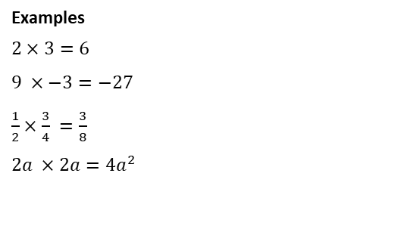
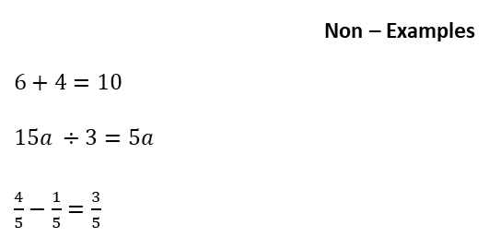
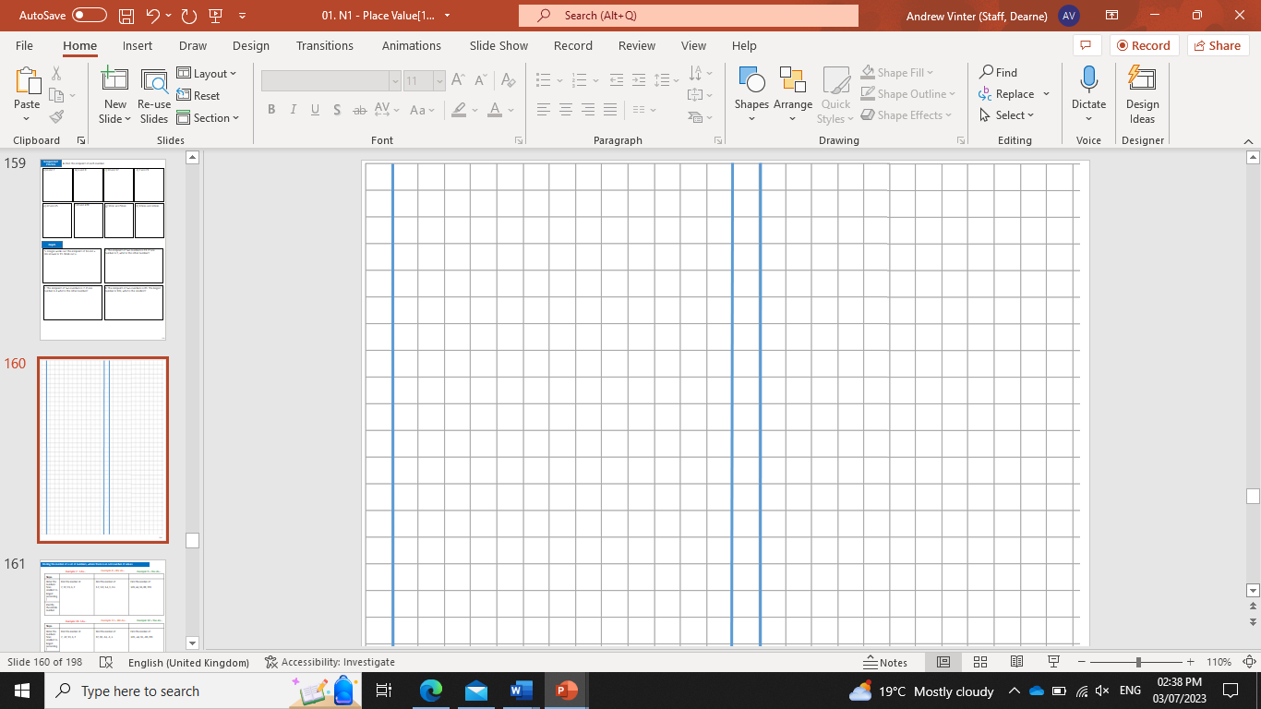
Subtopic N3.4 – Multiplication (without carrying)
LEARNING OUTCOME: To be able to use formal methods to multiply numbers (without carrying)
Objectives:
Keywords:
Multiply
Product
Integer
Digit
To be able to multiply by single digits
To be able to multiply three-digit numbers
To solve worded problems involving multiplication
Introduction – read and annotate:
In this subtopic, you'll practise written multiplication methods that don’t require carrying, helping you
build accuracy and confidence with multiplying larger numbers. This is a key step before moving on to
more complex methods.
Definition
The result of multiplying two or more numbers or terms together.
Characteristics
Linked words include times, multiply and factor.
Multiplication does not always make numbers bigger.
Product
Multiplying 2-digit numbers by a single digit
Example 1 - I do…
Example 2 – We do…
Example 3 – You do…
Steps | Work out the following multiplication. | Work out the following multiplication. | Work out the following multiplication.
1) Multiply the single digit number by the ones column of the two digit. number 2) Multiply the single digit number by the tens column of the two digit number. | 32 x 3 | 22 x 4 | 22 x 3
96
88
66

Slide 2
Independent Practice
1. Calculate:
23 x 2 b) 34 x 2 c) 23 x 3
d) 31 x 3 e) 33 x 3 f) 21 x 4
g) 12 x 4 h) 21 x 3 i) 13 x 3
g) 32 x 2 h) 33 x 2 i) 43 x 2
46
68
69
93
99
84
93
99
84
64
66
86
Multiplying 3-digit numbers by a single digit
Example 4 - I do…
Example 5 – We do…
Example 6 – You do…
Steps | Find the product of the following numbers. | Find the product of the following numbers. | Find the product of the following numbers.
Multiply each digit of the three digit number by the single digit, starting with the ones column. | 122 x 4 | 341 x 2 | 312 x 3
488
682
936

Slide 3
Independent Practice
2. Calculate:
241 x 2 b) 321 x 3 c) 122 x 4
482
963
488
d) 201 x 3 e) 331 x 3 f) 102 x 4
603
993
408
g) 143 x 2 h) 330 x 3 i) 221 x 4
286
990
884
Multiplying 2-digit numbers by 2-digit numbers
Example 7 - I do…
Example 8 – We do…
Example 9 – You do…
Steps | Find the product of the following numbers. | Find the product of the following numbers. | Find the product of the following numbers.
1) Multiply the ones column of the second number by the ones and tens column of the first number 2) Multiply the tens column of the second number by the ones and tens column of the first number | 14 x 22 308 | 12 x 42 504 | 21 x 23 483

Slide 4
Independent Practice
3. Calculate:
42 x 21 b) 31 x 12 c) 23 x 22
882
372
506
d) 24 x 21 e) 13 x 12 f) 32 x 22
504
156
704
g) 34 x 21 h) 43 x 21 i) 43 x 22
714
903
946
j) 34 x 12 k) 41 x 22 l) 31 x 22
408
902
682
m) 13 x 22 n) 78 x 11 o) 52 x 11
286
858
572

Slide 5
Multiplying 3-digit numbers by 2-digit numbers
Example 10 - I do…
Example 11 – We do…
Example 12 – You do…
Steps | Find the product of the following numbers. | Find the product of the following numbers. | Find the product of the following numbers.
1) Multiply the ones column of the second number by the ones, tens and hundreds column number of the first number 2) Multiply the tens column of the second number by the ones, tens and hundreds column number of the first number | 131 x 32 | 213 x 23 | 121 x 42
4192
4899
5082
Independent Practice
4. Find the product of the following numbers.
423 x 21 b) 341 x 12 c) 243 x 22
d) 312 x 32 e) 232 x 31 f) 213 x 33
g) 122 x 43 h) 211 x 42 i) 121 x 44
8883
4092
5346
9984
7192
7029
5246
8862
5324

Slide 6
j) 412 x 22 k) 432 x 12 l) 403 x 11
9064
5184
4433
Worded problems involving column multiplication
Example 13 - I do…
Example 14 – We do…
Example 15 – You do…
James, a crane operator works on 4 hour shifts everyday. If he worked 122 days in a year, how many hours of work did he put in altogether? | Joy made 3 trips to the candy store. For every trip she made, she bought 31 packs of orange candies. How many packs of candies did Joy buy in total? | George visits a store to buy 3 Nintendo switch games. They are priced at £32 each. How much does he spend on his purchase?
488 hours
93 packs
£96
Example 16 - I do…
Example 17 – We do…
Example 18 – You do…
A Ferris wheel completes a rotation in 43 seconds. How many seconds in all would it take to complete 121 rotations? | A small dairy farm produces 32 gallons of milk in a day. How many gallons of milk will it produce in 213 days? | The auditorium at Lion’s school has 22 rows in all. If each row consists of 332 seats, calculate the total capacity of the auditorium?
5203 seconds
6816 gallons
7304 seats

Slide 7
Independent Practice
b) A rugby team brought 4 coaches of supporters to a cup match. Each coach held 121 supporter. How many supporters were brought to the match?
c) A cinema has 132 seats in each row. There are 3 rows. How many seats are there in total?
Jim goes to a movie with his dad and brother. Each movie ticket costs $23. How much in total does Jim pay for the tickets?
5. Work out the following:
$69
484 supporters
396 seats
e) The garden of a house is 33 square metres. Jeremiah wants to cover the entire garden with grass. Grass costs £21 per square metre. How much will the grass cost?
f) Andy is doing a charity carwash. He charges £13 per car and washes 312 cars. How much money did he make?
Eleanor goes to an ice hockey match. There were 12 blocks of seats with 431 seats in each block. How many seats were there altogether?
5172
£693
£4056
h) It takes an hour for a car manufacturing company to assemble 34 cars. How many cars can the company assemble in 210 hours?
i) A primary school are carpeting a classroom. The room is 21 square metre. The carpet is £322 per square metre. Calculate the cost of the carpet.
Clara and her friends take an average of 12 hours to mow a community lawn over a weekend. How many hours on an average will they take to mow 124 such lawns?
1488 hours
7140 hours
£6762

Slide 8
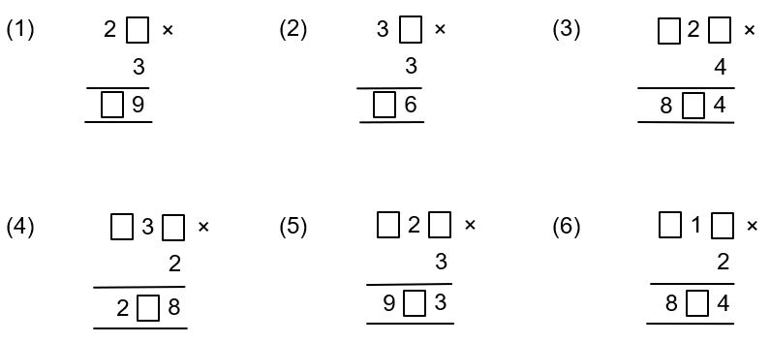
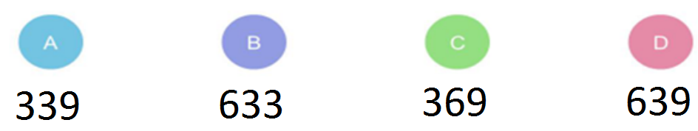
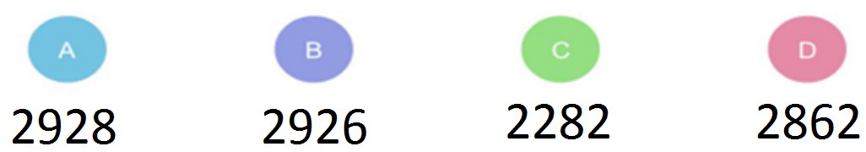
6. Find the missing digits for each calculation below:
(a)
3
(b)
2
(c)
2
1
6
9
8
(d)
1
4
(e)
3
1
(f)
4
2
6
6
2
Skills Check
1. Calculate:
213 x 3
2. Calculate:
122 x 24

